Slide 1

5c A caffeine-fuelled world
Reading
1 Work in groups. Discuss the questions.
1 Is your lifestyle very different to that of your parents’ generation? In what way(s)?
2 Do you often hear comments about modern life? What kind of comments?
3 How much tea/coffee or other drinks do you have in a normal day?
Students’ own answers
2 Read the article on page 63 quickly. Choose the correct option to complete the sentence.
The article is about caffeine and children / daily life / sugar.
5c-p. 62

Slide 2

Track 40
Over the centuries, people have created many traditions around preparing and drinking their favourite drinks, tea and coffee. Just think of the Japanese tea ceremony, British afternoon tea or the morning coffee custom in many societies. Why are these drinks so popular? The answer is their secret ingredient – caffeine. In the modern world, the new caffeine ‘delivery systems’ are canned ‘energy’ drinks. And the more modern our world gets, the more we seem to need caffeine.
Caffeinated drinks make you less tired and more alert. This double power of caffeine to reduce physical tiredness and increase alertness is part of the reason why it is the world’s most popular mood-changing drug. It is the only habit-forming drug we routinely serve to our children (in all those soft drinks and chocolate bars). In fact, most babies in the developed world are born with tiny amounts of caffeine in their bodies.
5c-p. 63

Slide 3
Track 40
Most people don’t think twice about their caffeine intake being harmful. However, it raises blood pressure and so increases the risk of heart disease. That’s why the use of caffeine is considered to be a problem by scientists and public health authorities. In the United States, for example, many canned energy drinks carry warnings. In most European countries, manufacturers have to label cans with warnings. But in France and Denmark you are not even allowed to sell energy drinks.
On the other hand, there’s also research which suggests that caffeine may have benefits for human health. It helps relieve pain, reduces asthma symptoms and increases reaction speed.
And it seems we need coffee – or Diet Coke® or Red Bull – to get us out of bed and back to work. Charles Czeisler, a neuroscientist at Harvard Medical School, explains that traditionally people went to sleep and woke up following sunset and sunrise. Then the way we worked changed and people did more indoor jobs. Consequently, we had to adapt. Electric light and caffeinated food and drink allowed people to follow a less natural work pattern. Therefore, without caffeine, the 24-hour society of the developed world simply couldn’t exist.
5c-p. 63

Slide 4

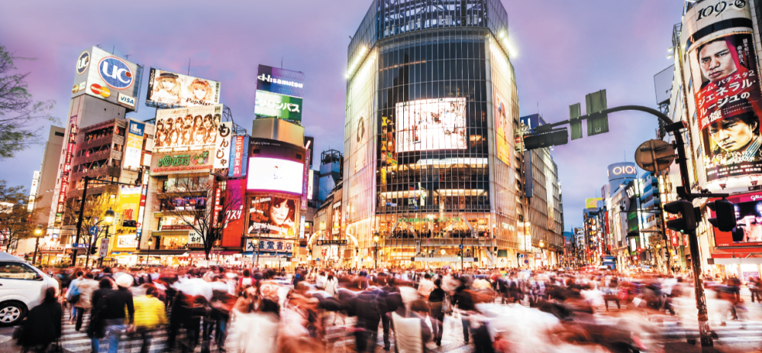
Track 40
Czeisler says, ‘Caffeine helps people try to ignore the natural human rhythms.’ He warns us that ‘there is a heavy, heavy price to pay’ for all this extra alertness. Without enough sleep – the traditional eight hours out of each 24 is about right – the human body will not function at its best, either physically, mentally, or emotionally, the doctor says.
According to Czeisler, the modern desire for caffeine is a ‘Catch 22 situation’. ‘The main reason that people want caffeine is to stay awake,’ he says. ‘But the main reason that people can’t stay awake is they don’t get enough regular sleep – because they use caffeine.’
The Shibuya Crossing in Tokyo, Japan is always busy.
5c-p. 63

Slide 5
5c A caffeine-fuelled world
2 Read the article on page 63 quickly. Choose the correct option to complete the sentence.
The article is about caffeine and children / daily life / sugar.
5c-p. 62

Slide 6
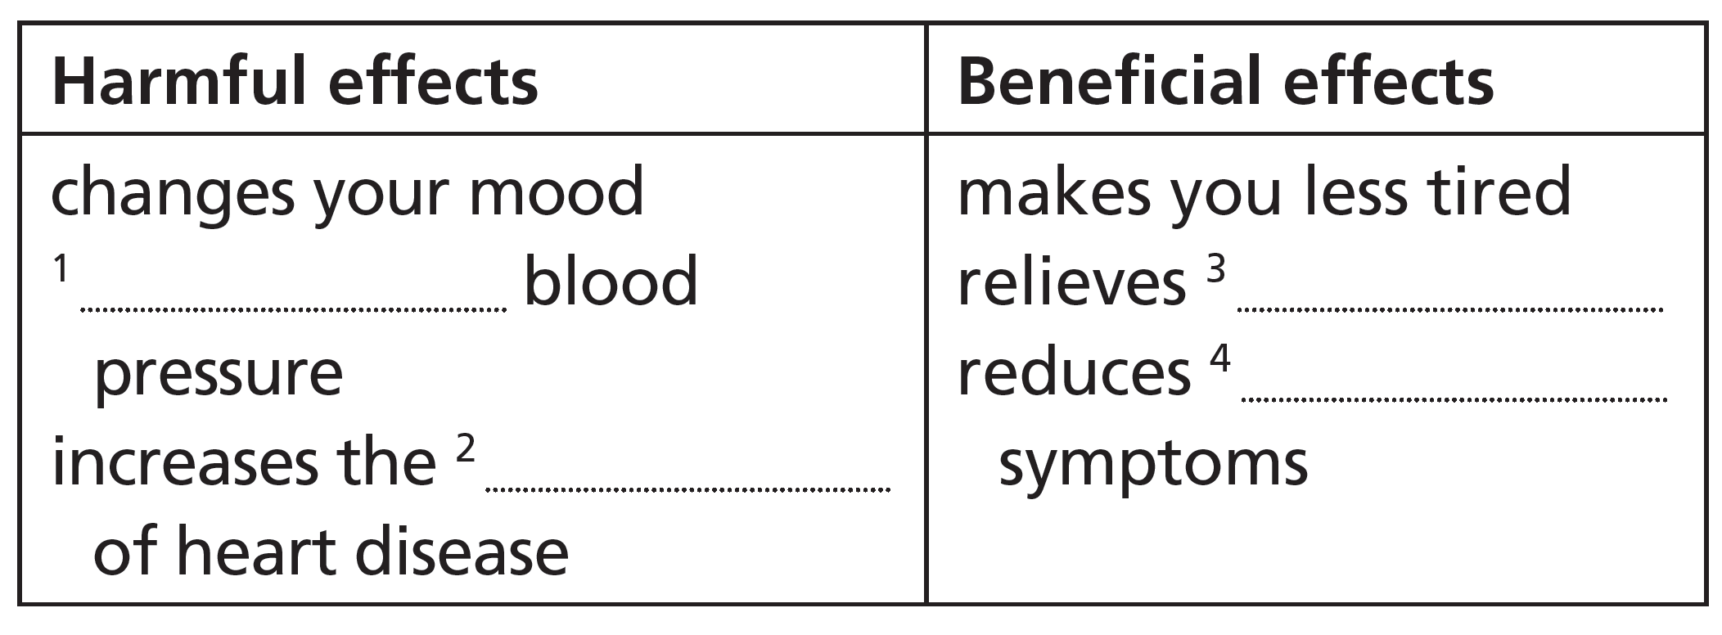
3 What are the effects of caffeine? Complete the table.
increases
pain
asthma
risk
4 Complete these sentences with words from the article.
1 Caffeine is an _____________ of tea, coffee, soft drinks, energy drinks and chocolate.
2 Caffeine is a drug which changes your _____________.
3 Several countries put health _____________ on energy drinks.
4 People have changed to a less natural work _____________.
5 Caffeine is popular with people who need to stay _____________.
ingredient
mood
warnings
pattern
awake
5 Work in pairs. Do you think anything the writer says is true about your own lifestyle? What?
5c-p. 62

Slide 7
Critical thinking writer’s purpose
6 What is the writer’s main purpose in this article? Give reasons for your answer.
to entertain / to inform / to persuade the reader
Students should include some of the information in the answer key to Exercise 7 when they give reasons.
7 Look at the list of features which are typical of informative texts. Find examples in the article.
1 the present simple
2 the third person
3 questions and answers
4 facts
5 specific examples
6 quotes, often from experts
7 linkers to show how ideas are connected
See next slide for answers
5c-p. 62

Slide 8
Exercise 7
1 present simple: used throughout, especially in paragraphs 1 (think, are, is, gets, seem), 2, 3, 5 and 6
2 third person: the first person (I) is never used
3 questions and answers: Why are these drinks so popular? The answer is their secret ingredient – caffeine.
4 facts: Caffeinated drinks make you less tired and more alert; In fact, most babies in the developed world are born with tiny amounts of caffeine in their bodies; … it [caffeine] raises blood pressure and so increases the risk of heart disease.
5 specific examples: In the United States, for example, many canned energy drinks carry warnings. / In most European countries, manufacturers have to label cans with warnings. But in France and Denmark you are not even allowed to sell energy drinks.
6 quotes, often from experts: Czeisler says, ‘Caffeine helps people try to ignore the natural human rhythms.’ He warns us that ‘there is a heavy, heavy price to pay’ for all this extra alertness; According to Czeisler, the modern desire for caffeine is a ‘Catch 22 situation’. ‘The main reason that people want caffeine is to stay awake,’ he says. ‘But the main reason that people can’t stay awake is they don’t get enough regular sleep – because they use caffeine.’
7 linkers to show how ideas are connected: In fact; However; But; On the other hand; And; Consequently; Therefore

Slide 9
8 Work in pairs. Discuss the questions.
1 Do you think the writer is successful in his/ her purpose?
2 Did you change your ideas about caffeine after reading the article?
3 In what way has the article influenced your opinion of caffeine?
1 The author is successful in informing the reader. Here are some of the many examples: Caffeinated drinks make you less tired and more alert … it raises blood pressure and so increases the risk of heart disease … there’s also research which suggests that caffeine may have benefits for human health.
2 Students' own answers
3 Students' own answers
5c-p. 62

Slide 10
Word focus so
9 Look at how so is used in the article. In which sentence can we replace so with as a result? What can replace so in the other sentence?
1 Why are these drinks so popular?
2 It raises blood pressure and so increases the risk of heart disease.
We can replace so with as a result in sentence 2.
We can replace so in sentence 1 with very or really.
5c-p. 62

Slide 11
10 Work in pairs. Complete the sentences. Then write two-line exchanges using some of the sentences. Act out your exchanges.
1 I’ve had five cups of ____________________ so far today.
2 Thank you so much for ____________________ you’ve done.
3 I’m so happy I could _______________________.
4 __________________________ me so I know when to expect you.
5 I think I’m right. I ____________________ so.
6 No, I don’t ____________________ so.
7 Don’t be so hard on yourself – it’s not easy to give up _______________________________.
8 Oh, that’s ________________________________________! So did I!
tea/coffee
what/all/everything
sing/dance/die/kiss you
Call/Ring/Text/Message
hope
think
chocolate/smoking/everything
remarkable/amazing/a coincidence
Students’ own ideas for the two-line dialogues
5c-p. 62

Slide 12

Speaking
11 Complete the slogans about modern life with these words. Where do you think the slogans are from?
1 We never _____________.
2 See the films of tomorrow _____________.
3 Open _____________ hours.
4 ‘Always’ _____________ broadband.
5 Late _____________ shopping every Thursday.
6 All _____________ breakfasts served here.
close
today
all
on
night
day
Students' own ideas for where the slogans are from, but see the Background information box for suggestions.
5c-p. 62

Slide 13
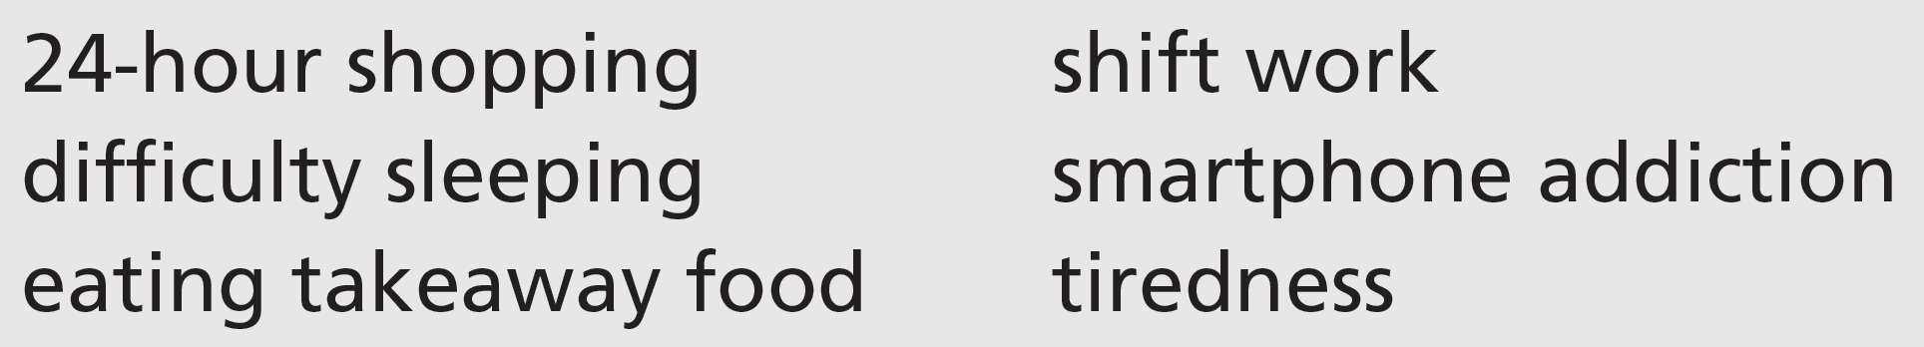
12 Work in small groups. These things are typical of a 24-hour society. Discuss the questions.
1 Are the things positive or negative?
2 Which ones affect you? In what way?
3 What are some of the consequences for you or for other people?
Students' own ideas
5c-p. 62

Slide 14
5e We look forward to your reply
Writing a formal letter/email
1 A group of students has written to the manager of a local supermarket. Read the letter quickly. What is its purpose? Choose the correct option (a–c).
a to ask about prices in the supermarket
b to complain about the supermarket’s actions
c to invite the supermarket to stock new products
5e-p. 65

Slide 15
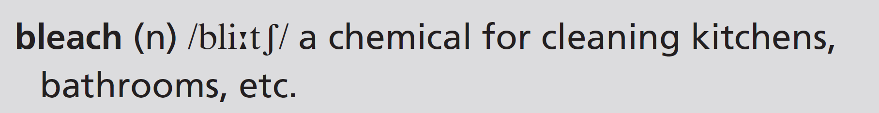
Dear Sir
We are writing to express our shock at the news that your supermarket is throwing out huge amounts of fresh food every day. Not only that, but you put bleach on the food and as a result it becomes inedible.
In our view, this will have serious consequences for people in need. As you may know, many people can’t afford to buy enough food every week. If you stop putting bleach on the food that you throw out, this will mean people can make use of it.
There are several local organizations that could use this unsold food. Will your supermarket consider working with them to pass on unwanted food to people who need it? Most food is still of good quality for some time after its sell-by date and therefore it should not be thrown out.
In addition, a lot of the unsold food that you throw out has reached its sell-by date. If your supermarket reduces the price of this food (as some of your competitors do), more people will be able to buy it. This will lead to less waste and more profit for you.
We look forward to your reply.
Yours faithfully
Year 11
Broadchurch High School
5e-p. 65

Slide 16
5e We look forward to your reply
Writing a formal letter/email
1 A group of students has written to the manager of a local supermarket. Read the letter quickly. What is its purpose? Choose the correct option (a–c).
a to ask about prices in the supermarket
b to complain about the supermarket’s actions
c to invite the supermarket to stock new products
5e-p. 65

Slide 17
2 Read the letter again. Answer the questions about each paragraph.
Paragraph 1
Paragraph 2
Paragraph 3
Paragraph 4
What two actions are the students writing about?
Who is affected by the supermarket’s actions?
What question do the writers have?
What alternatives do the writers suggest?
1 the supermarket is throwing out huge amounts of fresh food every day; it is also putting bleach on food
2 people who need the food
3 Will your supermarket consider working with them [local organizations] to pass on unwanted food to people who need it?
4 passing food on to local organizations, reducing the price of food when it reaches its sell-by-date
5e-p. 65

Slide 18
3 Writing skill explaining consequences
a Find these words in the letter. They link causes and consequences. For each word, underline the cause and circle the consequence.
1 as a result (paragraph 1)
2 mean (paragraph 2)
3 lead to (paragraph 4)
1 cause: you put bleach on the food
consequence: it becomes inedible
2 cause: If you stop putting bleach on the food that you throw out
consequence: people can make use of it
3 cause: more people (will be able to) buy it [the food]
consequence: less waste and more profit for you.
5e-p. 65

Slide 19
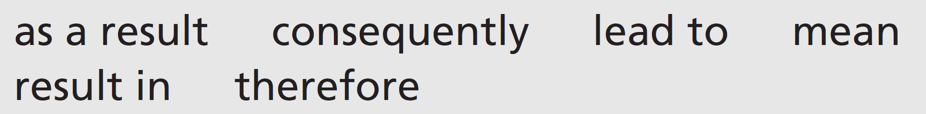
b Complete the sentences with these words. Sometimes, more than one option is possible.
1 We object strongly to this plan. __________________________________, we will not be able to support it.
2 We welcome the new community kitchen. This will ______________________________ more people eating a hot meal.
3 The prices have gone up. _______________________________________, fewer people will shop here.
4 New price policies _____________________ we’ll be able to buy more.
5 We suggest lowering prices as this could ___________________________ more customers coming in.
6 We reduced our prices and ______________________________________ increased the number of customers.
As a result / Consequently / Therefore
lead to / mean / result in
As a result / Consequently / Therefore
mean
mean / lead to / result in
as a result / consequently / therefore
5e-p. 65

Slide 20
4 Prepare a letter with your reaction to one of these situations. Make notes before you start. Use the questions in Exercise 2 to guide you.
• Your college is going to close the student cafeteria.
• Your favourite TV show is being scrapped.
• Your employer/school has banned junk food and drink machines.
• Your local swimming pool is being closed.
5 Write your letter. Follow the structure of the paragraphs in Exercise 2. Use these questions to check your letter.
• Is the style correct for a formal letter?
• Is the purpose of the letter clear?
• Is it clear what action the person who the letter is addressed to needs to take?
6 Exchange letters with your partner. Read your partner’s letter. Take the role of the person it is addressed to. Are you going to take any action as a result of the letter? Write a short reply to the letter.
5e-p. 65

Slide 21
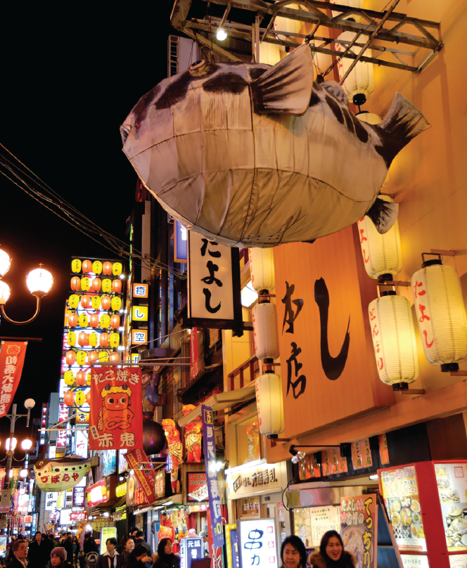
5f Dangerous dining
Before you watch
1 Look at the photo and write six words connected to it. Then work in pairs. Compare your list with your partner.
EXAMPLE ANSWERS
A possible list: fugu, fish, dangerous, Japan, Japanese, restaurant, neon, night, lights, dark
A fugu restaurant in Osaka, Japan
5f-p. 67

Slide 22
2 Key vocabulary
a Read the sentences. The words in bold are used in the video. Guess the meaning of the words.
1 Sugar is a major cause of people’s problems with their teeth.
2 Some snakes have poison in their teeth.
3 Check the regulations before you enter the competition.
4 Lots of people go to the dentist annually.
5 If you feel nervous, breathe in and out slowly.
b Match the words in bold in Exercise 2a with these definitions.
2
4
5
3
1
a something that can kill you if you eat or drink it
b every year
c take air into your lungs
d official rules
e important, big
5f-p. 67

Slide 23

Vide 5.1
While you watch
3 Watch the first part of the video (0.00– 0.42) with the sound OFF. Discuss the questions.
1 Which country are the people in?
2 What kind of food can you see?
3 What do you think could be dangerous about this food?
4 Watch the first part of the video again with the sound ON. Check your ideas from Exercise 1 and find out the name of the food.
1 Japan
2 puffer fish, or fugu
3 It’s poisonous unless properly prepared.
5 Watch the second part of the video (0.43–1.43) with the sound OFF. What do you think the diners (Tom and Aki) and the chef are saying to each other? Then watch with the sound ON and check your ideas.
Students’ own answers
5f-p. 67

Slide 24
6 Watch the whole video. Choose the correct option to complete the sentences.
1 A lot of people died from eating fugu after / during World War II.
2 At this time, licences for catching and selling / preparing and serving fugu were introduced.
3 There were 2,500 / 10,500 deaths from fugu from 1945 to 1975.
4 Nowadays only about three people die every year, mostly from poisoning at home / in restaurants.
5 One tiger fugu has enough toxin to kill 3 / 30 people.
6 The fugu toxin attacks a person’s heart / lungs.
5f-p.67

Slide 25
Videoscript
Dangerous dining
Part 1
0.00–0.39 Fish is a major food in Japan. Every morning, thousands of fish sellers crowd the famous Tsukiji seafood market in Tokyo. Here, no product has a higher price than the one that’s the most dangerous – the puffer fish, or fugu.
Eating this fish is like playing a dangerous game. If a person gets a piece that has poison in it, he or she may die! Despite the danger, fugu appears on more than 80 menus in the Asakusa restaurant area of Tokyo. The puffer is so ugly, it’s cute, but it doesn’t fool most diners.
Part 2
0.40–1.06 Tom Caradonna has come to Tokyo for the complete fugu experience, and he’s brought his friend, Aki. Wisely, Tom has chosen to eat at the famous Matsumoto restaurant. This fugu restaurant is 120 years old and it’s well-known for its careful preparation of puffer fish. That’s important when you’re taking risks with a toxin that is 1,000 times stronger than cyanide!
1.08–1.13 ‘I’ve heard stories about people dying by trying the fugu, but it hasn’t really concerned me.’
1.14–1.26 Even though Tom isn’t too worried to try fugu, there is a big risk. Over the years, hundreds of people have died from eating it. Chef Hayashi is the one who must prepare the fish safely so that Tom and Aki don’t get sick.
1.27–1.43 ‘It’ll be fine, don’t worry. I’ve been doing this for 53 years. I took the exam in 1949 and passed. This is my fugu chef licence.’

Slide 26
Videoscript
Dangerous dining
Part 3
1.44–2.26 After World War II, there were many deaths from eating fugu. Many Japanese people were very hungry, and some looked for food in restaurant rubbish. Sometimes they found fugu which had been thrown out. When they cooked and ate the fish, they got sick or died. Eventually, General Douglas MacArthur, who led the US forces in Japan, created strict controls and regulations. Fugu chefs had to get licences for preparing and serving puffer fish. Even with more regulations, fugu killed 2,500 Japanese people between 1945 and 1975. Regulations and education have cut the number of deaths to only three annually, but many diners still get sick.
2.27–2.37 ‘ About 70 per cent of the poisonings happen in private homes where people catch and prepare fugu on their own and get poisoned. That’s most common.’

Slide 27

After you watch
7 Vocabulary in context
a Watch the clips from the video. Choose the correct meaning of the words and phrases.
b Complete the sentences in your own words. Then work in pairs and compare your sentences.
1 I saw an advert for a holiday with a complete … experience.
2 One thing that concerns me is … .
3 The last time I got sick was … .
4 Have you ever fooled anyone?
5 Do people in your country eat mainly in restaurants or in private homes?
5 Students' own answers
EXAMPLE ANSWERS
1 I saw an advert for a holiday with a complete festival/ travel/adventure experience.
2 One thing that concerns me is next month’s exam/the weather.
3 The last time I got sick was when I was very young/when I was on holiday.
4 Yes, once when I performed a magic trick on a friend.
5f-p. 67

Slide 28
Videoscript
Dangerous dining
c
b
c
a
a
1 The puffer is so ugly it’s cute, but it doesn’t fool most diners.
a appeal to
b frighten
c trick
2 Tom Caradonna has come to Tokyo for the complete fugu experience.
a to catch fugu with local fishermen
b to eat all types of fugu dishes
c to report on deaths from fugu
3 ... but it hasn’t really concerned me.
a helped
b included
c worried
4 Chef Hayashi is the one who must prepare the fish safely so that Tom and Aki don’t get sick.
a become ill
b die
c enjoy the meal
5 About 70 per cent of the poisonings happen in private homes ...
a people’s houses
b secret places
c small restaurants

Slide 29
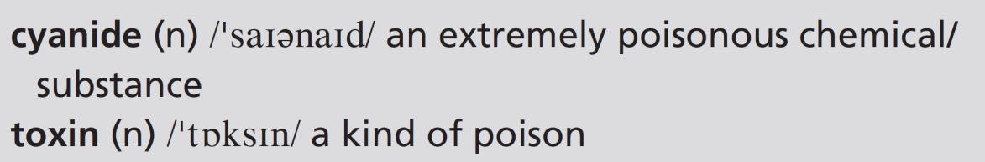
8 What, in your opinion, is the best ending (a–c) for this sentence? Compare with your partner.
The best way to avoid getting sick from fugu is:
a by going to a well-known restaurant.
b not to eat it.
c to take anti-toxin medicine.
Students’ own ideas
9 Work in pairs to prepare a survey on risk-taking. Look at the sentence in Exercise 8 and write three similar sentences for activities that include risks. Then ask your classmates their opinions. Which are the most popular responses?
5f-p. 67

Slide 30
UNIT 5 REVIEW AND MEMORY BOOSTER
Grammar
1 Read the conversation between two friends who are cooking. Cross out any incorrect options.
A: Do you know how to make risotto?
B: Oh yes. 1 I show / I’ll show you if you want.
A: OK, great. 2 Can / Must I use this pan?
B: Yes, sure. You 3 have to / don’t have to ask.
A: When the onion 4 is / will be ready, I add the rice.
B: Yes, then the liquid. But you 5 must / have to add it slowly. Don’t add more until the rice 6 absorbs / will absorb it.
A: OK, that’s all the liquid in. 7 Am I allowed to / Should I stir it all the time now?
U5 Review-p. 68

Slide 31
B: Yes, because you 8 must / mustn’t let it stick to the pan. If it 9 sticks / will stick, it will burn.
A: 10 Should I / Do I have to add salt?
B: You can if you want to, but you 11 mustn’t / don’t have to. And the risotto 12 can’t / has to rest for a while before 13 you eat / you’ll eat it.
A: 14 Am I allowed to / Do I have to taste it?
B: Of course you are. You made it!
2 Answer the questions about the conversation in Exercise 1.
1 Are the friends making a hot or a cold dish?
2 Why is it important to add the liquid slowly?
3 Why is it important to stir all the time?
1 hot
2 If you don’t add the liquid slowly, the rice won’t absorb the liquid.
3 If you don’t stir it all the time, it will stick to the pan.
U5 Review-p. 68

Slide 32

3 Work in pairs. Think of other modal verbs you can use in Exercise 1 items 2, 5, 7, 8, 10, 12 and 14. How does the meaning of the sentences change?
2 Do I have to: Is there another pan I can use? Should: Is it a good idea to use this pan?
5 should: it’s recommended
7 Can: I’d like to stir it all the time – is it OK if I do? Do I have to: Is it really important to stir it all the time?
8 shouldn’t: it isn’t recommended can’t: It’s a bad idea. If you do there will be a problem.
10 Can: I like salt, so is it OK if I add some? Must: Is salt absolutely necessary?
12 should: It’s recommended; it’s a good thing to let the risotto rest. must: It’s really important; the risotto won’t be good if it doesn’t rest.
14 Can: I’d like to taste the risotto – is it OK if I do? Must: I don’t really want to taste the risotto.
U5 Review-p. 68

Slide 33
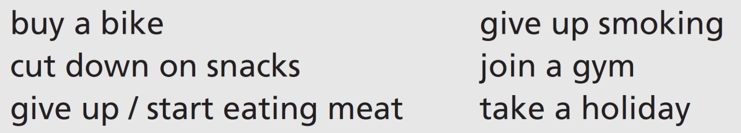
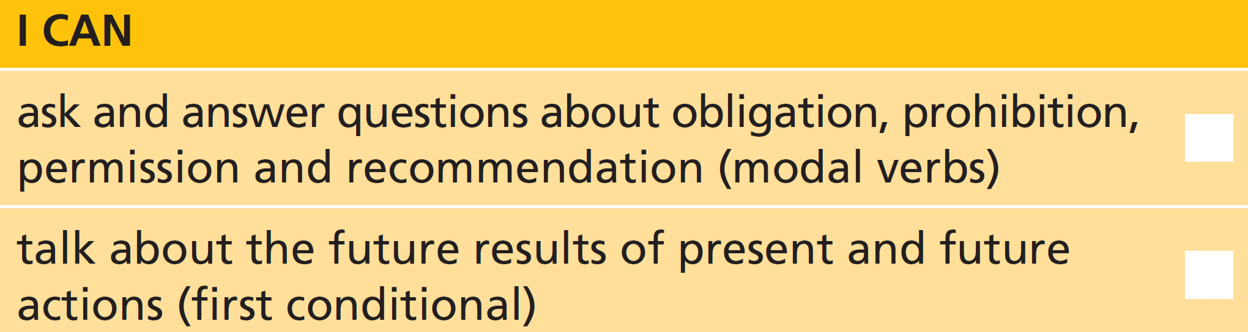
4 Work with a new partner. Take turns to state an intention and start a ‘chain’.
A: I think I’ll buy a bike.
B: If you buy a bike, you’ll get more exercise.
A: Yes. And if I get more exercise, …
U5 Review-p. 68

Slide 34

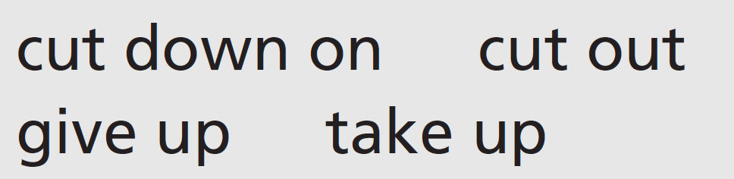
Vocabulary
5 Match the verbs about change with phrasal verbs that mean the same. One of the verbs matches two phrasal verbs. Then write four sentences describing a change that leads to a healthy lifestyle.
reduce = cut down on
start = take up
stop = give up / cut out
Possible sentences:
Cutting down on sugar in your diet can help you lose weight and also helps to avoid problems with your teeth. If you want to get fit, you should take up a new form of exercise. Most people agree that giving up smoking is a good idea. When I wanted to lose weight and look after my heart I cut out very fatty foods from my diet.
U5 Review-p. 68

Slide 35
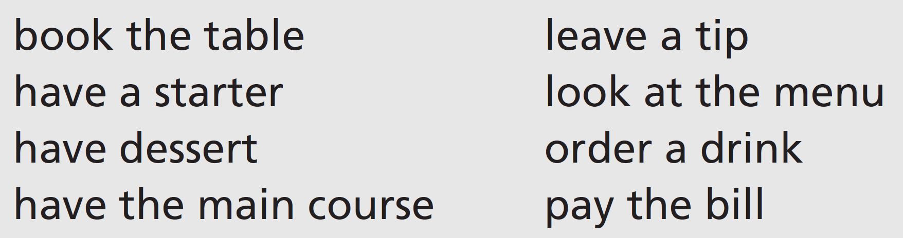
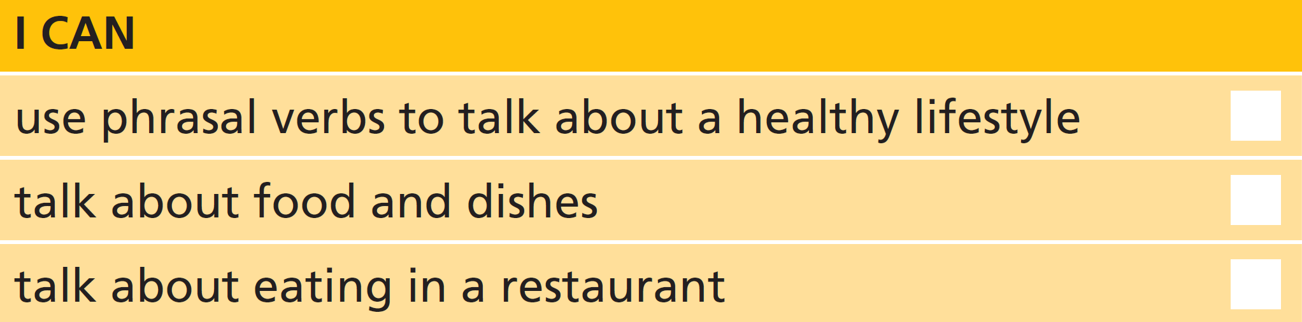
6 Find four things you can eat in Unit 5. Think of two ways to describe each one. Then work in pairs. Try and guess your partner’s things.
7 Work in pairs. Tell your partner if you never, always or sometimes do these things when you eat out. Explain your reasons.
EXAMPLE ANSWERS
I sometimes book the table when we eat out in a restaurant, but usually my husband does it.
I never have a starter – I don’t want to eat too much so I save myself for the dessert instead!
I usually leave a tip, because I think it’s important to show your appreciation of the service in a restaurant.
I always pay the bill by credit card. It’s easier that way and it means I have a record of how much I paid.
U5 Review-p. 68

Slide 36
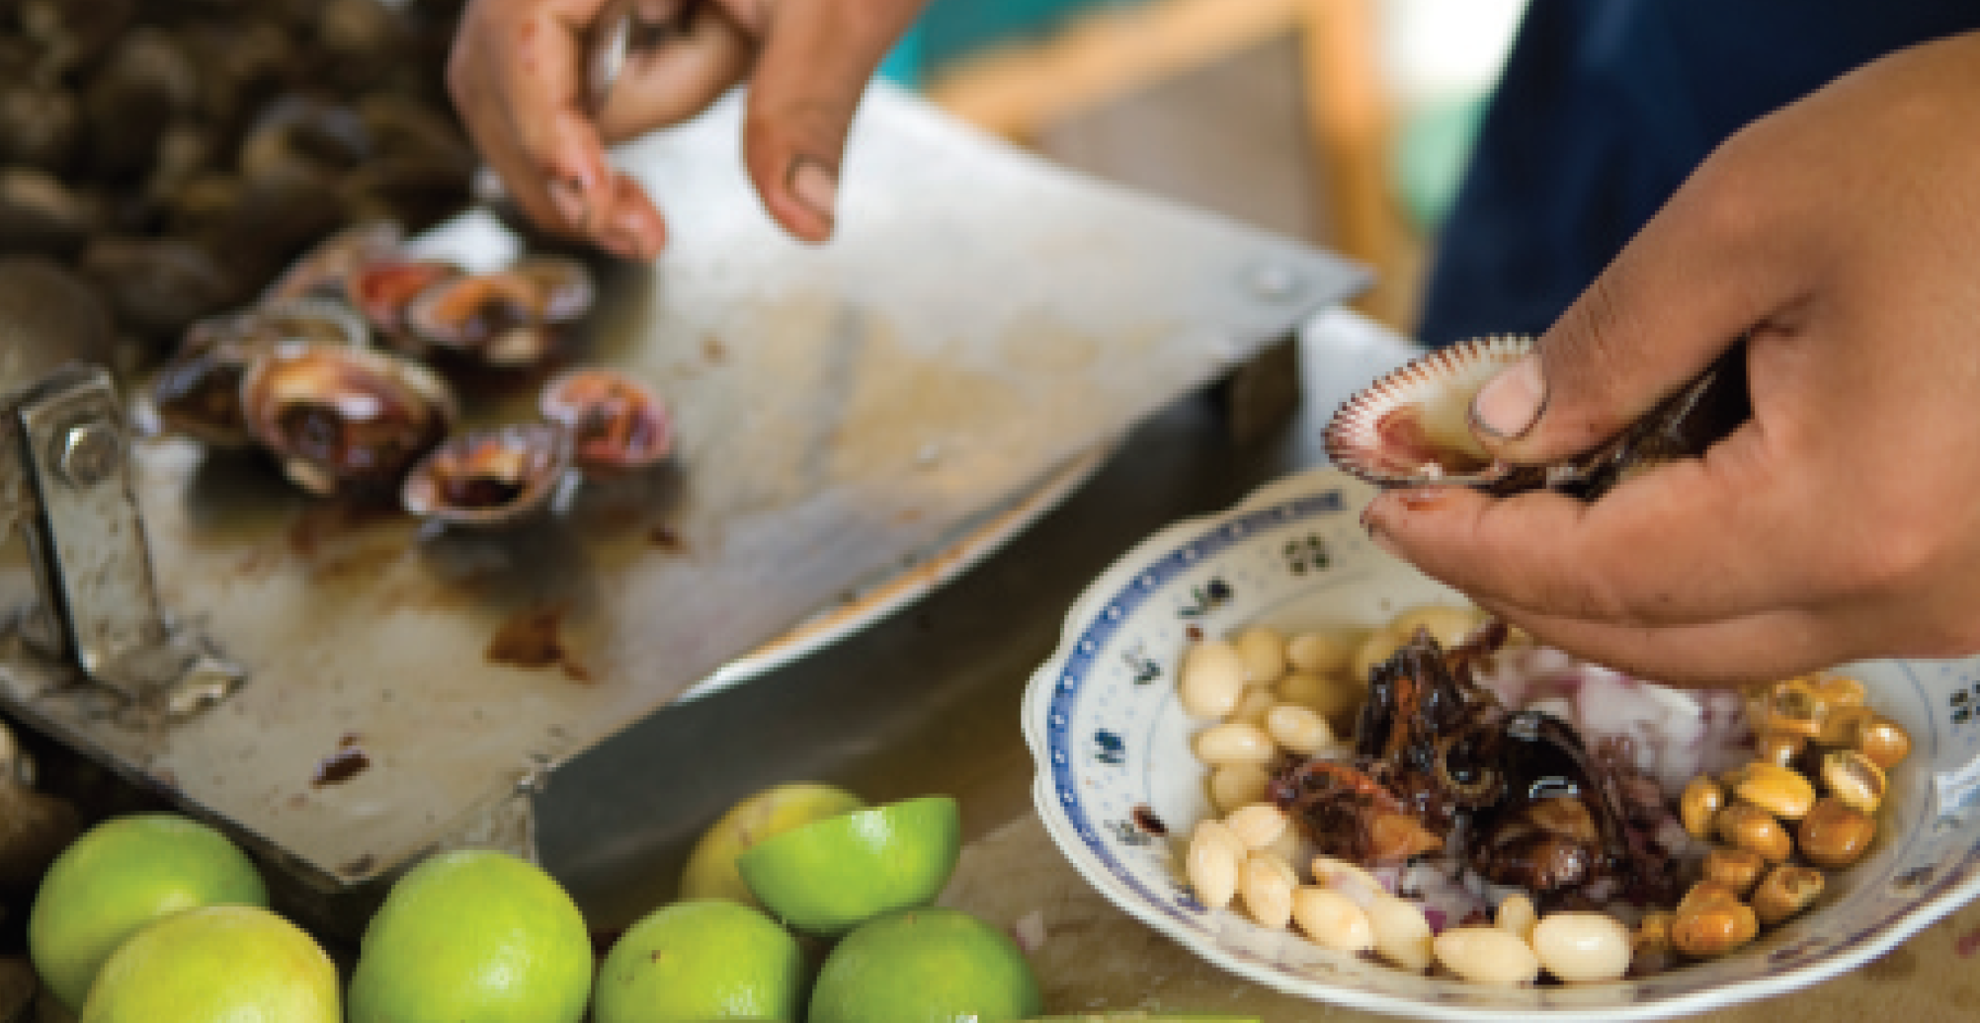
Real life
8 Complete the description of a seafood dish with these words. There is one extra word.
Ceviche is a Latin American dish. It’s a 1 ____________ of seafood dish. It’s 2 ____________ by using the juice of citrus 3 ____________, in this case limes, to ‘cook’ a mix of 4 ____________ fish and seafood.
kind/sort
made
fruit
raw
U5 Review-p. 68

Slide 37
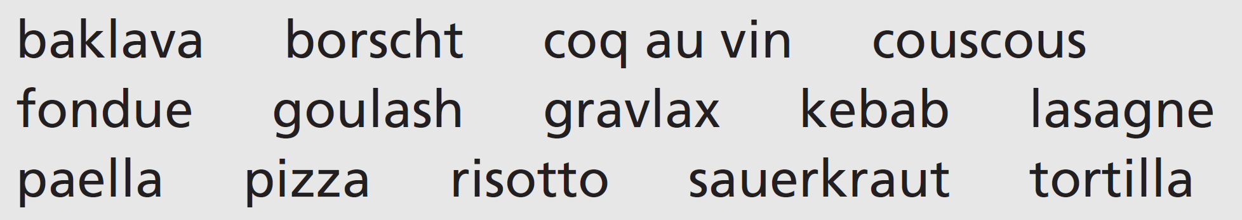

9 Work in groups. Prepare descriptions of as many dishes from the list as you can. Then compare your descriptions with other groups. Are there any dishes nobody is familiar with? Look at page 155 to find out what they are.
U5 Review-p. 68

Slide 38
Communication activities
UNIT 5 Review Exercise 9, page 58
Baklava
A rich, sweet pastry with chopped nuts and syrup or honey. From Turkey, the Caucasus and central Asia.
Borscht
A soup popular in many Eastern and Central European countries. Main ingredient: beetroot.
Coq au vin
A French chicken stew cooked with wine, mushrooms, herbs and garlic.
Couscous
From North Africa. A dish of semolina served with a meat or vegetable stew.
Fondue
Popular in Switzerland and France originally. Pieces of bread are dipped into a dish of melted cheese.
Goulash
A Hungarian meat soup or stew, flavoured with paprika.
Gravlax
Raw salmon cured in salt, sugar and the herb dill. From Scandinavia.
p. 155

Slide 39
Communication activities
UNIT 5 Review Exercise 9, page 58
Kebab
Cubes of meat (or fish) on a skewer, cooked over an open fire. Originally from Central and Western Asia.
Lasagne
An Italian dish of pasta sheets layered with cheese, meat and tomato sauce and baked in the oven.
Paella
A rice dish originally from Valencia, Spain. Rice is cooked in a shallow dish with meat or seafood. Saffron flavours and colours the rice.
Sauerkraut
From northern Europe. Shredded cabbage is fermented until it has a sour flavour.
Tortilla
1 A type of flatbread made from corn or wheat in Central America.
2 A potato omelette from Spain.
p. 155

